Slide 1
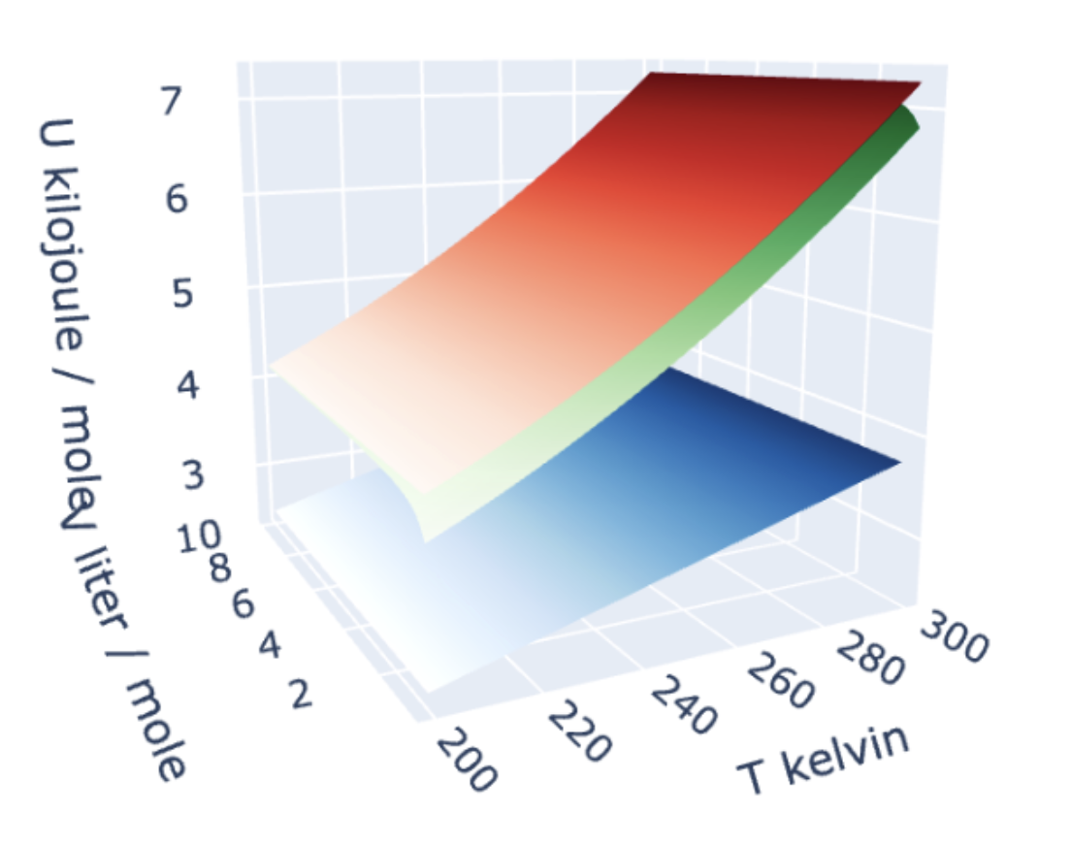
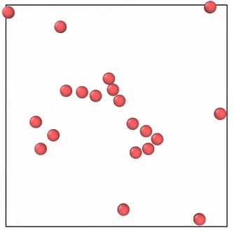
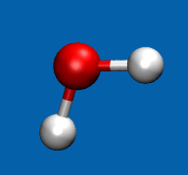
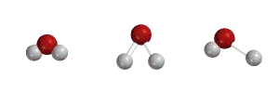
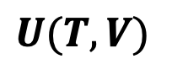
Recap: $U(T,V)$ is a measure of a system’s energy
The energy in a sample (say, a mole of gas) can take various forms:
There’s translational and rotational motion, which is all kinetic energy:
$$U(T,V)$$
There’s also vibrational motion, in which kinetic energy and potential energy are constantly trading off.

Slide 2
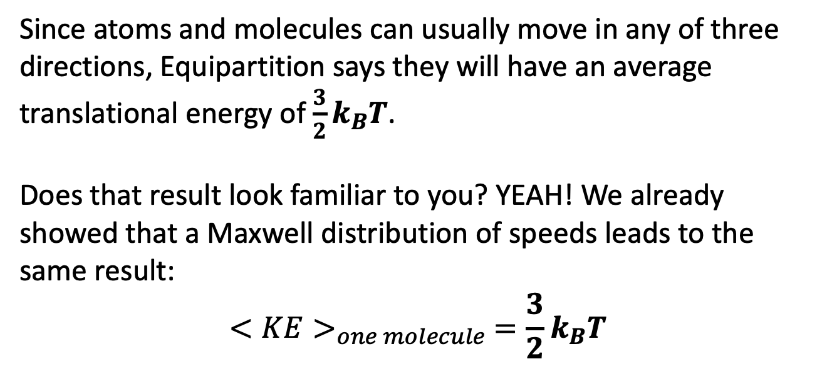
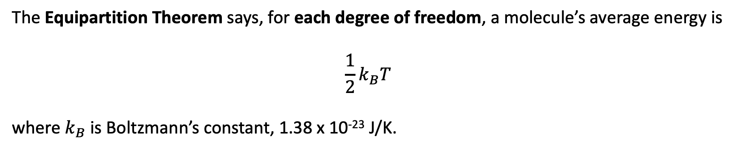
Predicting $U(T,V)$ from the Equipartition Theorem
The Equipartition Theorem says, for each degree of freedom, a molecule’s average energy is
$$\frac{1}{2}k_{B}T$$
where $k_{B}$ is Boltzmann’s constant, 1.38 x 10⁻²³ J/K.
Since atoms and molecules can usually move in any of three directions, Equipartition says they will have an average translational energy of $\frac{3}{2}k_{B}T$.
Does that result look familiar to you? YEAH! We already showed that a Maxwell distribution of speeds leads to the same result:
$$<KE>_{one molecule} =\frac{3}{2}k_{B}T$$

Slide 3
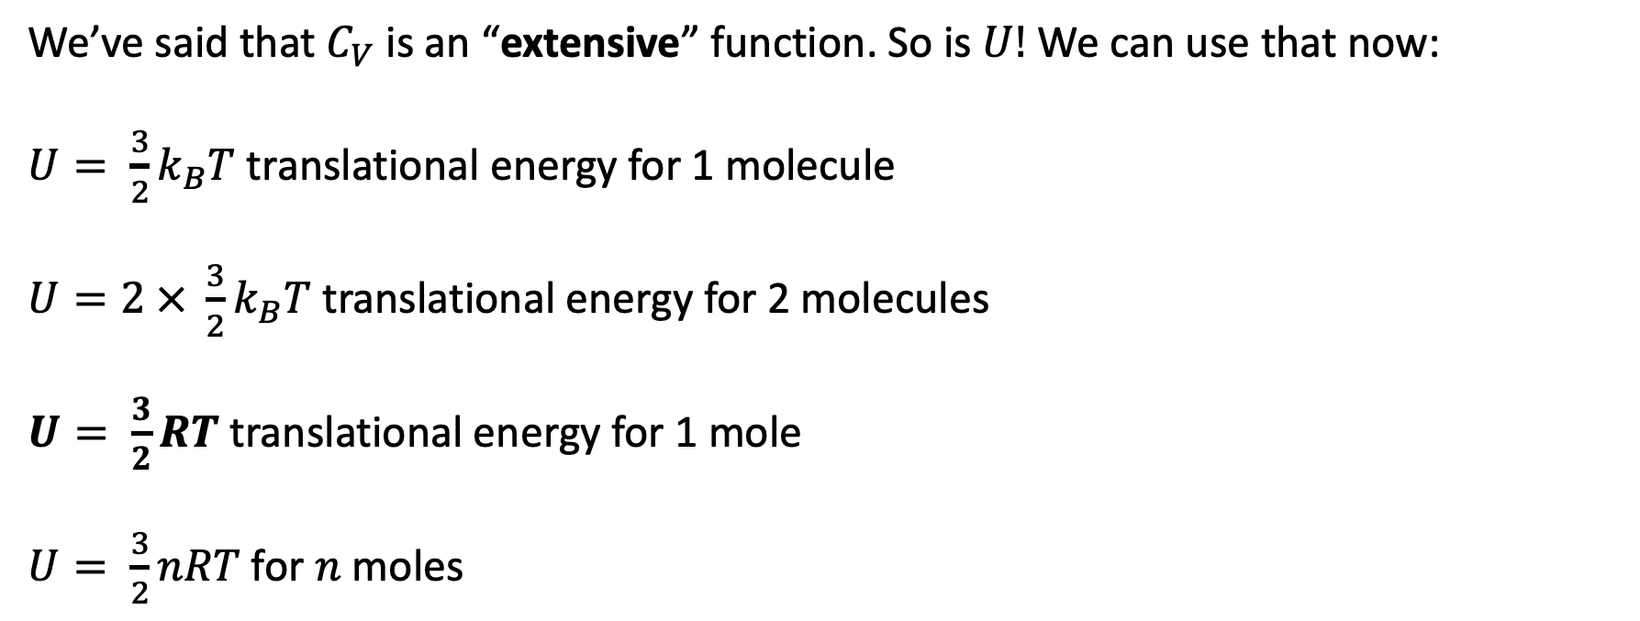
Scaling up using the principle of extensivity
We’ve said that $C_{V}$ is an “extensive” function. So is $U$! We can use that now:
$U= \frac{3}{2}k_{B}T$ translational energy for 1 molecule
$U=2 × \frac{3}{2}k_{B}T$ translational energy for 2 molecules
$U= \frac{3}{2}RT$ translational energy for 1 mole
$U= \frac{3}{2}nRT$ for $n$ moles

Slide 4


Our graphs clearly show $U$going up with increasing temperature
$$U(T,V)$$
Faster at high T
Slower at low T

Slide 5

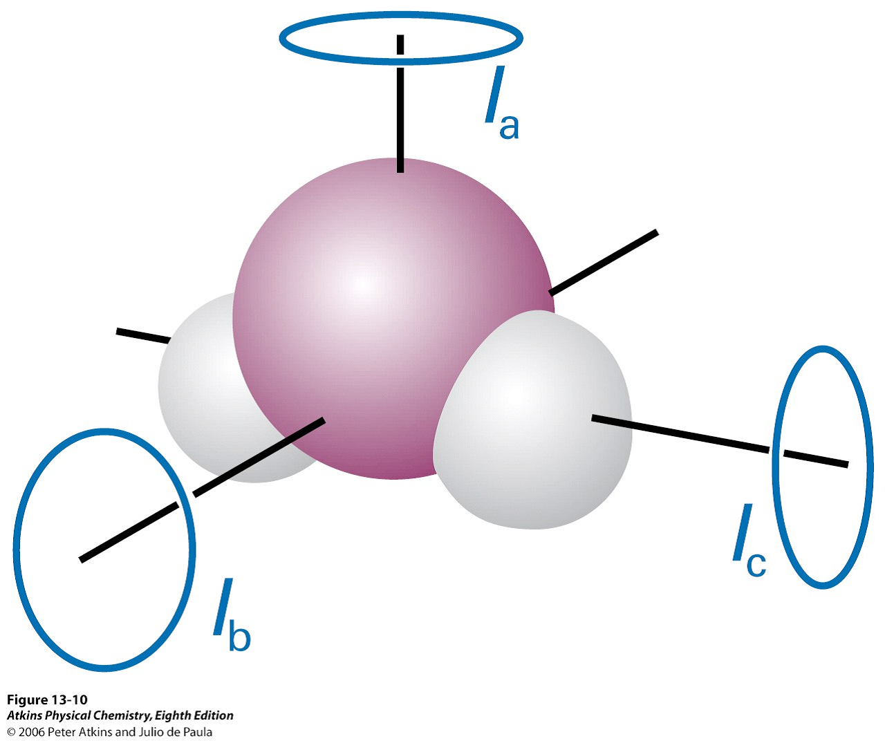
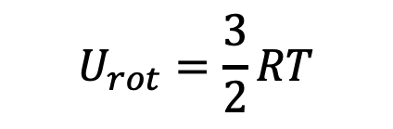

But molecules have more ways to soak up energy than just translational kinetic energy
Diatomic/Linear molecules can rotate in-plane and out-of-plane, so two rotational degrees of freedom
$$U_{rot}= \frac{2}{2}RT$$
Nonlinear molecules can rotate in three distinct directions ( called principal axes), so three rotational degrees of freedom
$$U_{rot}=\frac{3}{2}RT$$

Slide 6
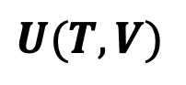
Why do we think those other modes will get their $\frac{1}{2}RT$ (for each degree of freedom)?
We’ve already mentioned the process of transfer of energy from one degree of freedom to another: thermalization. In this case, it’s translational -> rotational thermalization.
$$U(T,V)$$

Slide 7
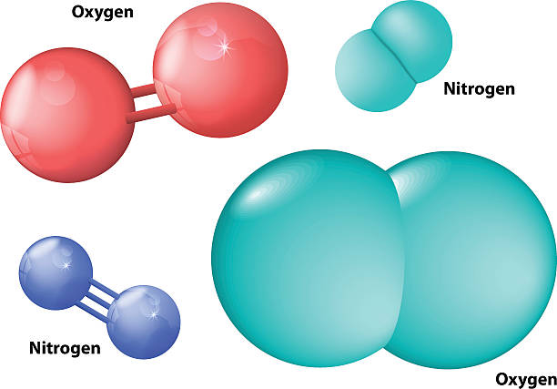
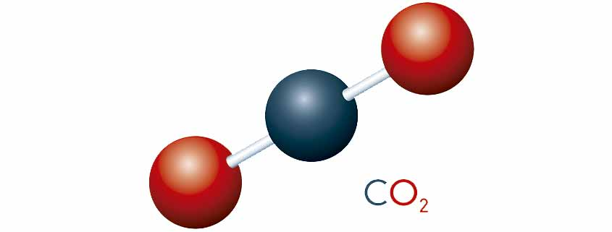
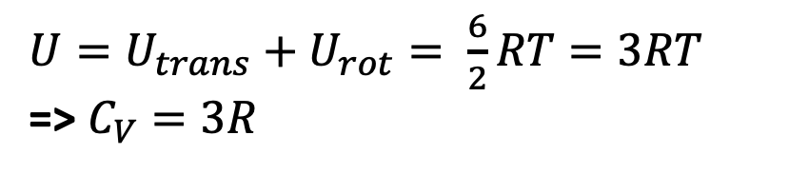
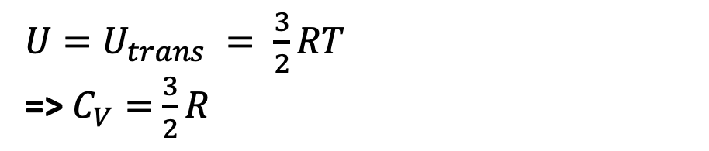
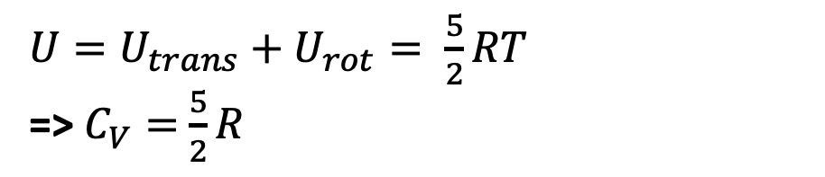
Why am I telling you all this? B/C it shows how to build up $U$ and $C_{V}$
$U=U_{trans} = \frac{3}{2}RT$
=> $C_{V}=$ $\frac{3}{2}R$
Atomic gas
Diatomic and linear molecules
${U=U_{trans}+U}_{rot}= \frac{5}{2}RT$
=> $C_{V}=$ $\frac{5}{2}R$
Nonlinear molecules
${U=U_{trans}+U}_{rot}= \frac{6}{2}RT=3RT$
=> $C_{V}=3R$

Slide 8
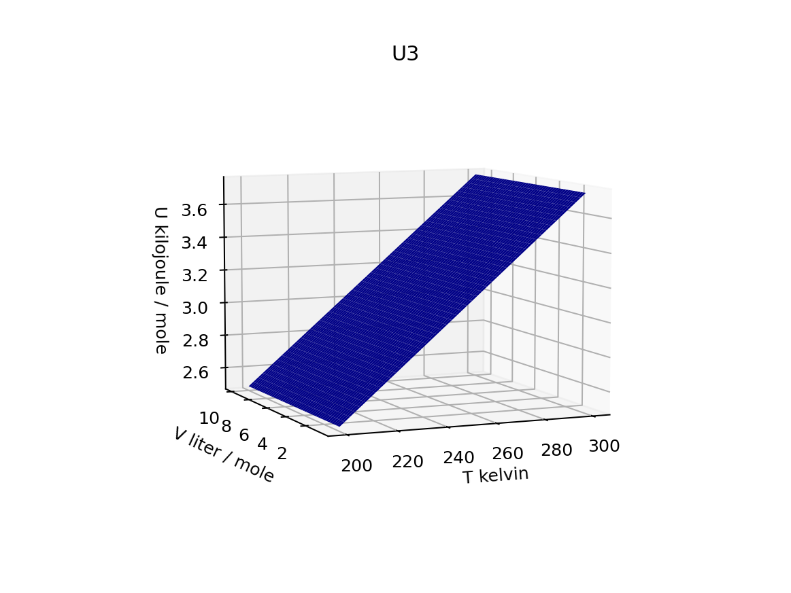
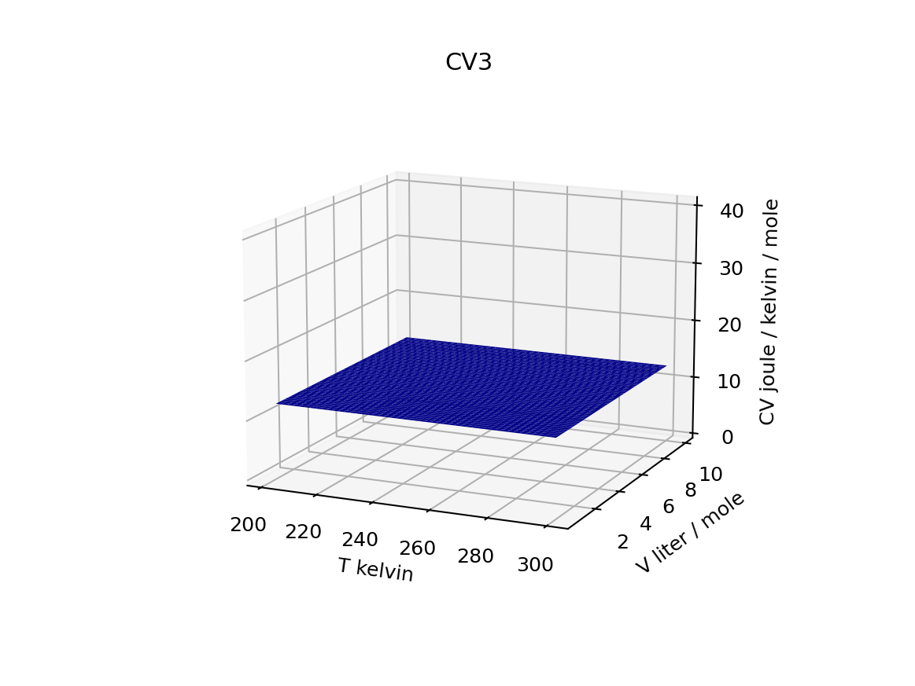
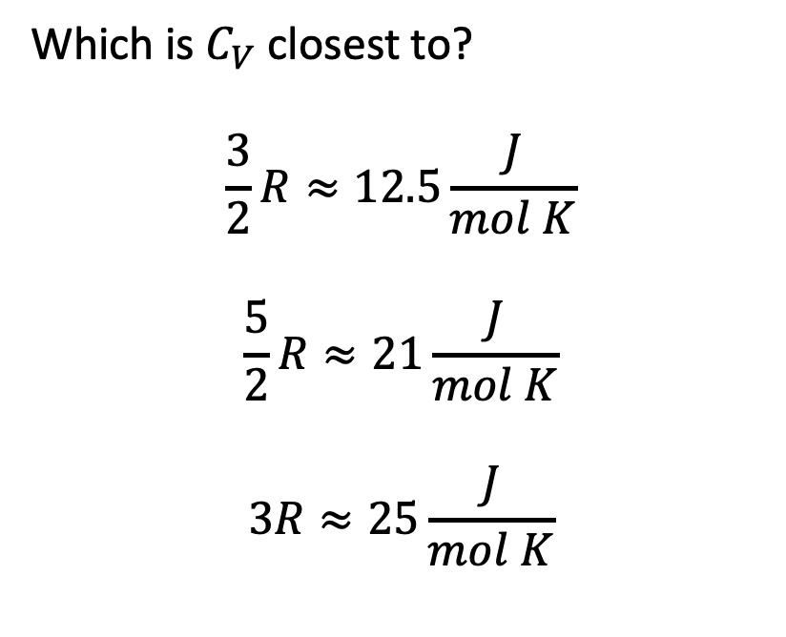
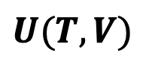
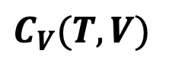
We can tell whether this molecule can rotate by looking at its (constant) ${C_{V}≡\left(\frac{∂U}{∂T}\right)}_{V}$
$$U(T,V)$$
Which is $C_{V}$ closest to?
$$\frac{3}{2}R≈12.5\frac{J}{mol K}$$
$$\frac{5}{2}R≈21\frac{J}{mol K}$$
$$3R≈25\frac{J}{mol K}$$
$$C_{V}(T,V)$$

Slide 9
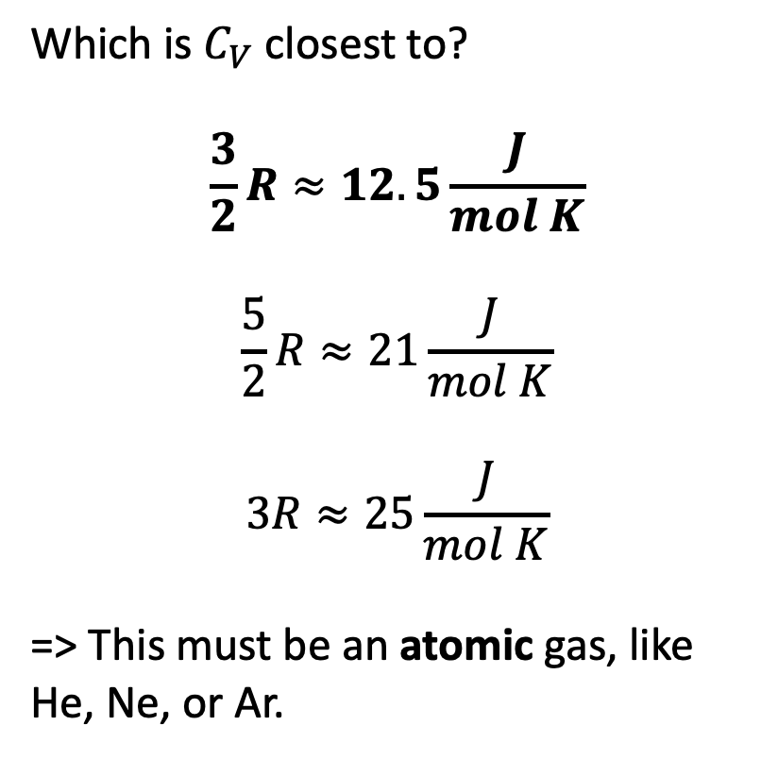
We can tell whether this molecule can rotate by looking at its (constant) ${C_{V}≡\left(\frac{∂U}{∂T}\right)}_{V}$
$$U(T,V)$$
Which is $C_{V}$ closest to?
$$\frac{3}{2}R≈12.5\frac{J}{mol K}$$
$$\frac{5}{2}R≈21\frac{J}{mol K}$$
$$3R≈25\frac{J}{mol K}$$
=> This must be an atomic gas, like He, Ne, or Ar.
$$C_{V}(T,V)$$

Slide 10
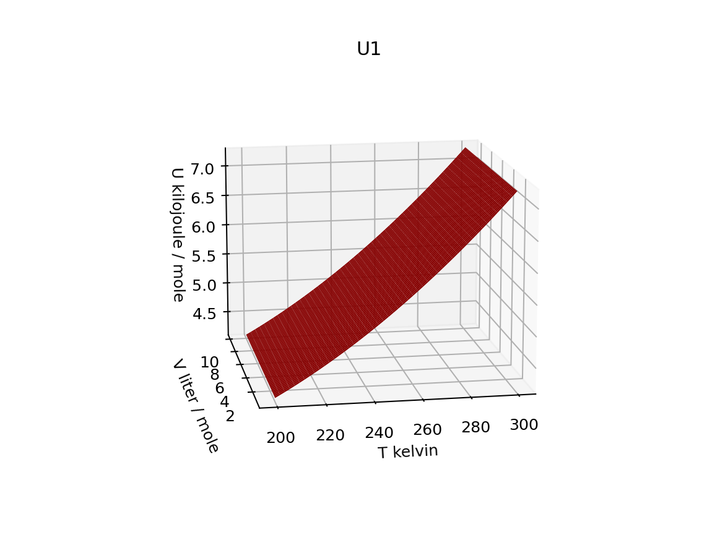
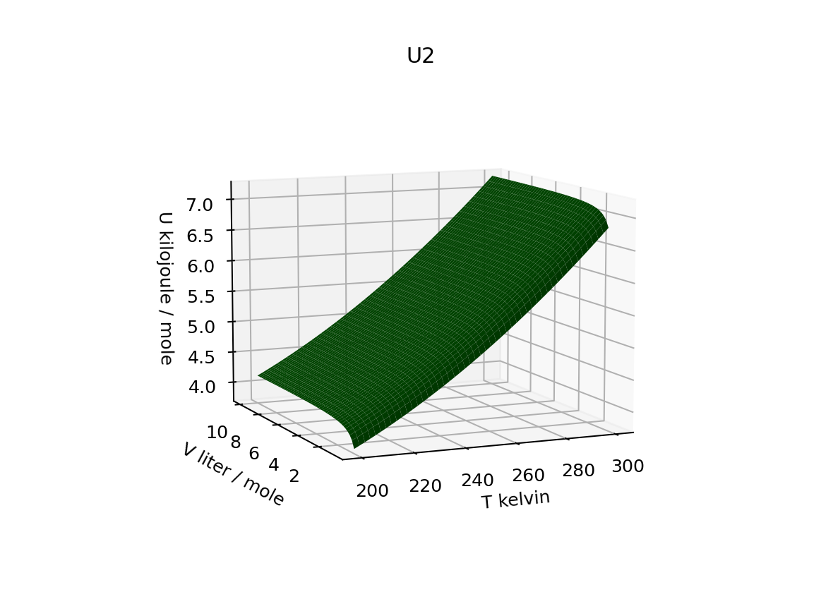
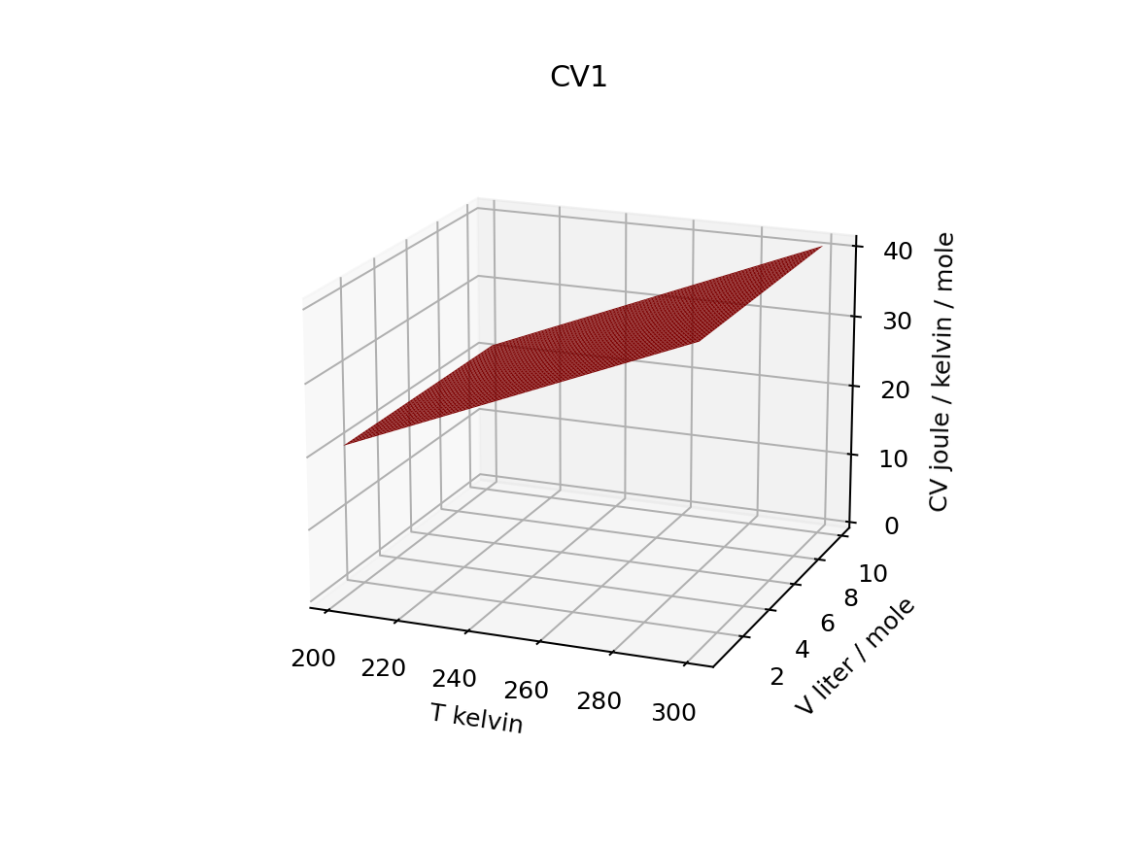
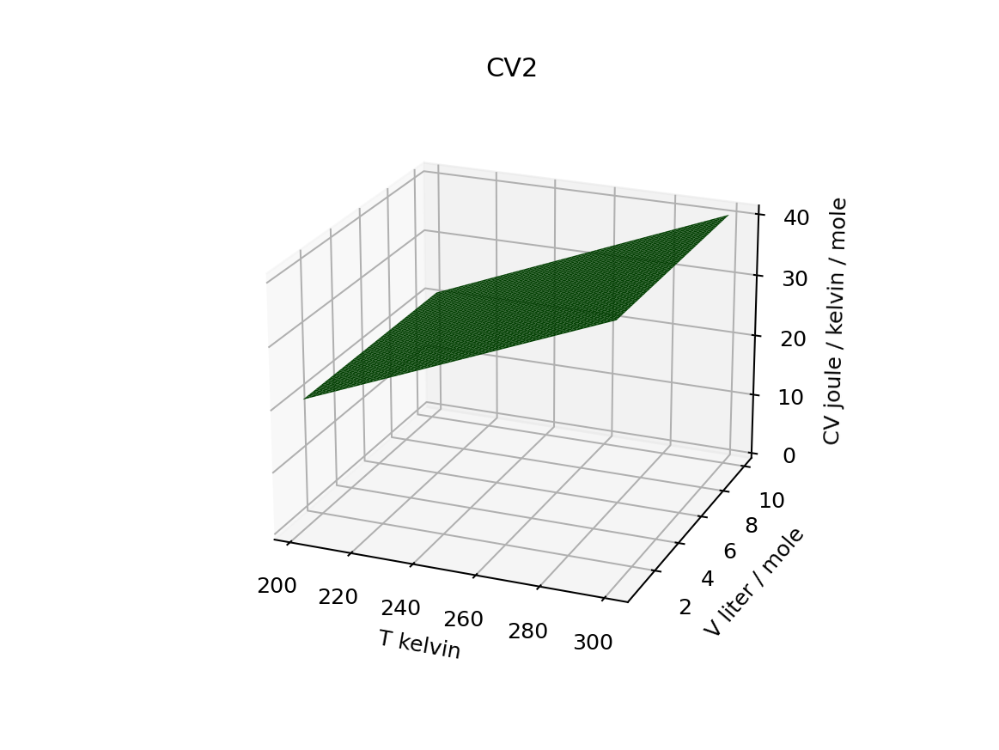
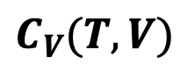
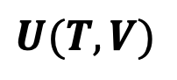
Now … what can we learn from the fact that the other two don’t have constant $C_{V}$?
$$U(T,V)$$
$$C_{V}(T,V)$$
Constant slope in the temperature direction
Increasing slope in the temperature direction

Slide 11
To understand these, we have to understand how molecules vibrate
$$U(T,V)$$
$$C_{V}(T,V)$$
Constant slope in the temperature direction
Increasing slope in the temperature direction

